Slide 1

Shift Left Security 101
A Friday Training Hour by Anthony McKale
Head of Devops
Date 10– 03 - 2023

Slide 2
Shift Left Security 101
Table of Contents
HISTORY Software Tooling
BACKGROUND Tooling in SSDLC / Dora
IMPLEMENTATION Shift Left Security Tooling
Software Tooling Pre-History
Software Tooling Modern History
Secure Software Development Lifecycle 101
SSDLC Principles
SCA
SBOM
SAST (Secrets)
SAST (Code Smells)

Slide 3
History Lessons
Software Tooling Pre-History
Software Tooling Modern History

Slide 4
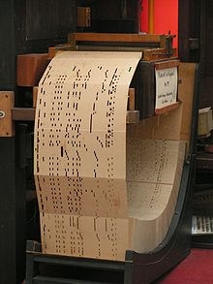
History: Software Tooling Pre-History
01
Software Tooling Pre-History
https://sites.google.com/site/histryofcomputers/limited-function-early-computers/1801-punched-card-technology

Slide 5
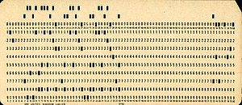
Software Tooling Pre-History
Punchcard Coding
Once upon a time in the 1920s
Code was written in punched 0 / 1s into paper
https://en.wikipedia.org/wiki/Punched_card

Slide 6
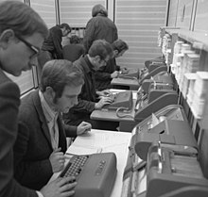
Software Tooling Pre-History
Punchcard Coding
The paper code had two major mechanical problems…
The code failed to run as expected
because of these physical issues
https://en.wikipedia.org/wiki/Punched_card

Slide 7
Software Tooling Pre-History
Punchcard Coding
The paper code had two major mechanical problems…
The code failed to run as expected
because of these physical issues
Main villains of the punch-card
Computer era were Bugs and Lint
https://en.wikipedia.org/wiki/Punched_card

Slide 8
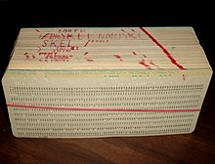
Software Tooling Pre-History
Punchcard Coding: BUGS
Insects hid and ate the paper
So, the first debugger was made*
Manually looking over each page to literally remove and kill the paper-eating bugs…*
https://en.wikipedia.org/wiki/Computer_programming_in_the_punched_card_era
https://en.wikipedia.org/wiki/Bug_(engineering)
* Note: the BUG term has competing origin stories, I was told this personally by someone of the punch-card era

Slide 9
Software Tooling Pre-History
Punchcard Coding: LINT
Paper punch-cards rubbed and gathered paper lint
Small lint balls confused the optical sensors reading the punched holes
The first Sticky roller linter was made to literally remove small paper lint balls…
https://en.wikipedia.org/wiki/Lint_(software)

Slide 10
Software Tooling Pre-History
Punchcard Coding: LINT
History Questions ?
https://en.wikipedia.org/wiki/Lint_(software)

Slide 11
Software Tooling Pre-History
These now have new meanings
Debugging – is now a manual process for actively finding logic issues
Linting - is now a automated process for passively finding confusing code
many other new tools have been made…

Slide 12
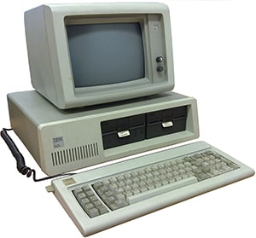
History: Software Tooling Modern History
02
Software Tooling Modern History
https://www.crucial.com.au/blog/2016/05/05/the-history-of-the-modern-computer/

Slide 13
Very Brief Software Tooling History
pre-1970s
1970s
1990s
2010s

Slide 14
Very Brief Software Tooling History
pre-1970s
1970s
1990s
2010s
Avent of Modern Computing - Automated Syntax Checking
- Automated Linting
- Manual Debugging

Slide 15
Very Brief Software Tooling History
pre-1970s
1970s
1990s
2010s
Avent of Modern Computing - Automated Syntax Checking
- Automated Linting
- Manual Debugging
Age of Waterfall Introduced Manual Testing as a common place practice Added Automated System integration Manual Quality Control Testing Default

Slide 16
Very Brief Software Tooling History
pre-1970s
1970s
1990s
2010s
Avent of Modern Computing - Automated Syntax Checking
- Automated Linting
- Manual Debugging
Age of Waterfall Introduced Manual Testing as a common place practice Added Automated System integration Manual Quality Control Testing Default
Age of Agile
Introduced Manual Testing as a common place practice Pushed for smaller faster testing as standard integrated process to ensure quality BDD Integration Testing evolved Automated Quality Assurance Unit Testing now Default

Slide 17
Very Brief Software Tooling History
pre-1970s
1970s
1990s
2010s
Avent of Modern Computing - Automated Syntax Checking
- Automated Linting
- Manual Debugging
Age of Waterfall Introduced Manual Testing as a common place practice Added Automated System integration Manual Quality Control Testing Default
Age of Agile
Introduced Manual Testing as a common place practice Pushed for smaller faster testing as standard integrated process to ensure quality BDD Integration Testing evolved Automated API Documenters like Javadoc where formalised Automated Quality Assurance Unit Testing now Default
40k Age of Strife Everything is on the internet Everything built ontop of many components Software Supply Chain attacks, and data hijacks abound Automated Security Testing now Default * Along side Quality Assurance Testing

Slide 18
Modern Software Tooling
Standard Static Tools
Linter API Documenters Security Code Testers - SCA - SAST Code - SAST Secrets - SAST IAC Config
Standard Dynamic Tools Debugger (manual) Unit Testing Integration Testing
Security Application Testers - DAST

Slide 19
Modern Software Tooling
Standard Static Tools
Linter API Documenters Security Code Testers - SCA - SAST Code - SAST Secrets - SAST IAC Config
Standard Dynamic Tools Debugger (manual) Unit Testing Integration Testing
Security Application Testers - DAST

Slide 20
History: Software Tooling Modern History
Software Tooling Modern History
History Questions ?
https://www.crucial.com.au/blog/2016/05/05/the-history-of-the-modern-computer/

Slide 21
Shift Left Security 101
Table of Contents
HISTORY Software Tooling
BACKGROUND Tooling in SSDLC / Dora
IMPLEMENTATION Shift Left Security Tooling
Software Tooling Pre-History
Software Tooling Modern History
Secure Software Development Lifecycle 101
SSDLC Principles
SCA
SBOM
SAST (Secrets)
SAST (Code Smells)

Slide 22
SSDLC 101
SSDLC 101 ( Secure Software Development Lifecycle )
SSDLC Principles
Google’s Dora

Slide 23
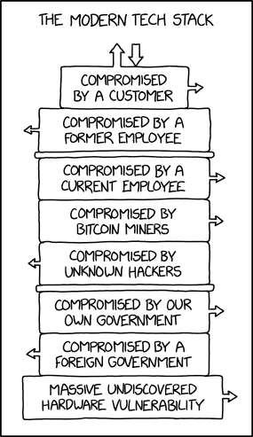
Secure Software Development Lifecycle
01 SSDLC
https://xkcd.com/2166/

Slide 24
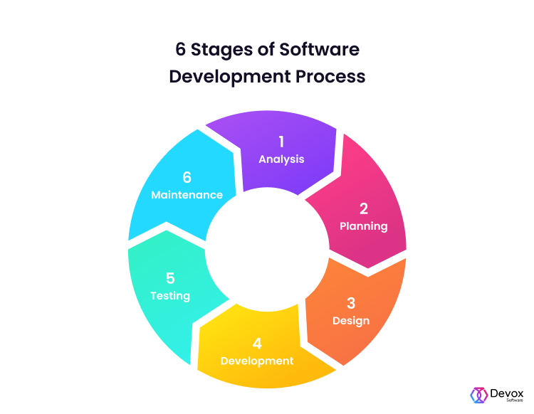
SSDLC 101
Standard: Software Development Lifecycle
Software dev follows 6 stages
Analysis
Planning
Design
Development
Testing
Maintenance
https://en.wikipedia.org/wiki/Systems_development_life_cycle https://devoxsoftware.com/blog/software-development-lifecycle/
Notes:
Vision film
This is about ambition.
An ambition to improve.
This is about change.
A change to the way things are done.
This is about technology.
Technology that makes brilliant ideas happen.
This is about desire
A desire to stay ahead and succeed.
We know every client is different.
That every challenge is different.
We’re here to harness technology.
To extract maximum value from data.
To navigate complexity.
To secure the right outcome.
Across sectors.
Across the world.
Across every project.
Again and again and again.
Whether building a single click.
To search a million documents.
Or connecting hundreds of data points.
To accelerate decision making.
This is transformation.
Planned right.
Designed right.
Built right.
And delivered right.
This is transformation secured.
That makes brilliant ideas happen.
In the right way.
Welcome to 6point6.
Transformation secured.
Architecture | Cloud | Data | Engineering | Cyber security.

Slide 25
SSDLC 101
SDLC: Software Development Lifecycle
What is different in SSDLC ? Secure Software Development Lifecycle
https://en.wikipedia.org/wiki/Systems_development_life_cycle https://devoxsoftware.com/blog/software-development-lifecycle/
Notes:
Vision film
This is about ambition.
An ambition to improve.
This is about change.
A change to the way things are done.
This is about technology.
Technology that makes brilliant ideas happen.
This is about desire
A desire to stay ahead and succeed.
We know every client is different.
That every challenge is different.
We’re here to harness technology.
To extract maximum value from data.
To navigate complexity.
To secure the right outcome.
Across sectors.
Across the world.
Across every project.
Again and again and again.
Whether building a single click.
To search a million documents.
Or connecting hundreds of data points.
To accelerate decision making.
This is transformation.
Planned right.
Designed right.
Built right.
And delivered right.
This is transformation secured.
That makes brilliant ideas happen.
In the right way.
Welcome to 6point6.
Transformation secured.
Architecture | Cloud | Data | Engineering | Cyber security.

Slide 26
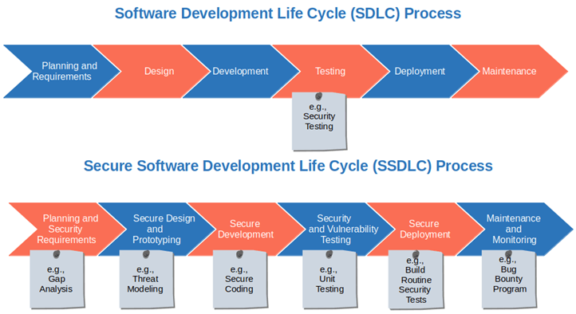
SSDLC 101
SSDLC: Secure Software Development Lifecycle
Secure Software Development Lifecycle integrates Security Assurance processes into every step Rather than just using Security Control steps like PEN tests at the end It’s Quality Assurance over Quality Control
https://codesigningstore.com/secure-software-development-life-cycle-sdlc * ask me about stages in SDLC if you spot it
Notes:
Vision film
This is about ambition.
An ambition to improve.
This is about change.
A change to the way things are done.
This is about technology.
Technology that makes brilliant ideas happen.
This is about desire
A desire to stay ahead and succeed.
We know every client is different.
That every challenge is different.
We’re here to harness technology.
To extract maximum value from data.
To navigate complexity.
To secure the right outcome.
Across sectors.
Across the world.
Across every project.
Again and again and again.
Whether building a single click.
To search a million documents.
Or connecting hundreds of data points.
To accelerate decision making.
This is transformation.
Planned right.
Designed right.
Built right.
And delivered right.
This is transformation secured.
That makes brilliant ideas happen.
In the right way.
Welcome to 6point6.
Transformation secured.
Architecture | Cloud | Data | Engineering | Cyber security.

Slide 27
SSDLC Principles
Planning
Coding + Testing
Deploying + Operating
SSDLC: Secure Software Development Lifecycle
Big topic, these are the cliffnotes
Notes:
Vision film
This is about ambition.
An ambition to improve.
This is about change.
A change to the way things are done.
This is about technology.
Technology that makes brilliant ideas happen.
This is about desire
A desire to stay ahead and succeed.
We know every client is different.
That every challenge is different.
We’re here to harness technology.
To extract maximum value from data.
To navigate complexity.
To secure the right outcome.
Across sectors.
Across the world.
Across every project.
Again and again and again.
Whether building a single click.
To search a million documents.
Or connecting hundreds of data points.
To accelerate decision making.
This is transformation.
Planned right.
Designed right.
Built right.
And delivered right.
This is transformation secured.
That makes brilliant ideas happen.
In the right way.
Welcome to 6point6.
Transformation secured.
Architecture | Cloud | Data | Engineering | Cyber security.

Slide 28
SSDLC Principles
Planning:
Define Security Requirements
Secure by Design
Threat Model
SSDLC: Secure Software Development Lifecycle
Big topic, these are the cliffnotes
Notes:
Vision film
This is about ambition.
An ambition to improve.
This is about change.
A change to the way things are done.
This is about technology.
Technology that makes brilliant ideas happen.
This is about desire
A desire to stay ahead and succeed.
We know every client is different.
That every challenge is different.
We’re here to harness technology.
To extract maximum value from data.
To navigate complexity.
To secure the right outcome.
Across sectors.
Across the world.
Across every project.
Again and again and again.
Whether building a single click.
To search a million documents.
Or connecting hundreds of data points.
To accelerate decision making.
This is transformation.
Planned right.
Designed right.
Built right.
And delivered right.
This is transformation secured.
That makes brilliant ideas happen.
In the right way.
Welcome to 6point6.
Transformation secured.
Architecture | Cloud | Data | Engineering | Cyber security.

Slide 29
SSDLC Principles
Coding:
Code reviews
Static code analysis (SAST)
Testing:
Test Security Requirements
Do not turn off security features during testing! “Authn/z”
SSDLC: Secure Software Development Lifecycle
Big topic, these are the cliffnotes
Notes:
Vision film
This is about ambition.
An ambition to improve.
This is about change.
A change to the way things are done.
This is about technology.
Technology that makes brilliant ideas happen.
This is about desire
A desire to stay ahead and succeed.
We know every client is different.
That every challenge is different.
We’re here to harness technology.
To extract maximum value from data.
To navigate complexity.
To secure the right outcome.
Across sectors.
Across the world.
Across every project.
Again and again and again.
Whether building a single click.
To search a million documents.
Or connecting hundreds of data points.
To accelerate decision making.
This is transformation.
Planned right.
Designed right.
Built right.
And delivered right.
This is transformation secured.
That makes brilliant ideas happen.
In the right way.
Welcome to 6point6.
Transformation secured.
Architecture | Cloud | Data | Engineering | Cyber security.

Slide 30
SSDLC Principles
Deploying:
Software Composition Analysis (SCA)
Everything as Code (IAC)
Operating:
Always Authn/z (zero trust)
Dynamic Application Security Testing (DAST)
Logging and Monitoring (Alerts and Alarms)
SSDLC: Secure Software Development Lifecycle
Big topic, these are the cliffnotes
Notes:
Vision film
This is about ambition.
An ambition to improve.
This is about change.
A change to the way things are done.
This is about technology.
Technology that makes brilliant ideas happen.
This is about desire
A desire to stay ahead and succeed.
We know every client is different.
That every challenge is different.
We’re here to harness technology.
To extract maximum value from data.
To navigate complexity.
To secure the right outcome.
Across sectors.
Across the world.
Across every project.
Again and again and again.
Whether building a single click.
To search a million documents.
Or connecting hundreds of data points.
To accelerate decision making.
This is transformation.
Planned right.
Designed right.
Built right.
And delivered right.
This is transformation secured.
That makes brilliant ideas happen.
In the right way.
Welcome to 6point6.
Transformation secured.
Architecture | Cloud | Data | Engineering | Cyber security.

Slide 31
SSDLC Principles
Planning:
Define Security Requirements
Secure by Design
Threat Model
Coding:
Code reviews
Static code analysis (SAST)
Testing:
Test Security Requirements
Do not turn off security features during testing! “Authn/z”
Deploying:
Software Composition Analysis (SCA)
Everything as Code (IAC)
Operating:
Always Authn/z (zero trust)
Dynamic Application Security Testing (DAST)
Logging and Monitoring (Alerts and Alarms)
SSDLC: Secure Software Development Lifecycle
Big topic, these are the cliffnotes
Notes:
Vision film
This is about ambition.
An ambition to improve.
This is about change.
A change to the way things are done.
This is about technology.
Technology that makes brilliant ideas happen.
This is about desire
A desire to stay ahead and succeed.
We know every client is different.
That every challenge is different.
We’re here to harness technology.
To extract maximum value from data.
To navigate complexity.
To secure the right outcome.
Across sectors.
Across the world.
Across every project.
Again and again and again.
Whether building a single click.
To search a million documents.
Or connecting hundreds of data points.
To accelerate decision making.
This is transformation.
Planned right.
Designed right.
Built right.
And delivered right.
This is transformation secured.
That makes brilliant ideas happen.
In the right way.
Welcome to 6point6.
Transformation secured.
Architecture | Cloud | Data | Engineering | Cyber security.

Slide 32
SSDLC Principles
Planning:
Define Security Requirements
Secure by Design
Threat Model
Coding:
Code reviews
Static code analysis (SAST)
Testing:
Test Security Requirements
Do not turn off security features during testing! “Authn/z”
Deploying:
Software Composition Analysis (SCA)
Everything as Code (IAC)
Operating:
Always Authn/z (zero trust)
Dynamic Application Security Testing (DAST)
Logging and Monitoring (Alerts and Alarms)
SSDLC: Secure Software Development Lifecycle
SSDLC Questions ? Else, onto SAST and SCA
Notes:
Vision film
This is about ambition.
An ambition to improve.
This is about change.
A change to the way things are done.
This is about technology.
Technology that makes brilliant ideas happen.
This is about desire
A desire to stay ahead and succeed.
We know every client is different.
That every challenge is different.
We’re here to harness technology.
To extract maximum value from data.
To navigate complexity.
To secure the right outcome.
Across sectors.
Across the world.
Across every project.
Again and again and again.
Whether building a single click.
To search a million documents.
Or connecting hundreds of data points.
To accelerate decision making.
This is transformation.
Planned right.
Designed right.
Built right.
And delivered right.
This is transformation secured.
That makes brilliant ideas happen.
In the right way.
Welcome to 6point6.
Transformation secured.
Architecture | Cloud | Data | Engineering | Cyber security.

Slide 33
Shift Left Security 101
Table of Contents
HISTORY Software Tooling
BACKGROUND Tooling in SSDLC / Dora
IMPLEMENTATION Shift Left Security Tooling
Software Tooling Pre-History
Software Tooling Modern History
Secure Software Development Lifecycle 101
SSDLC Principles
SCA
SBOM
SAST (Secrets)
SAST (Code Smells)

Slide 34
Shift Left Security 101 (Security Assurance in Code)
SCA
SBOM
SAST (Secrets)
SAST (Code Smells)

Slide 35
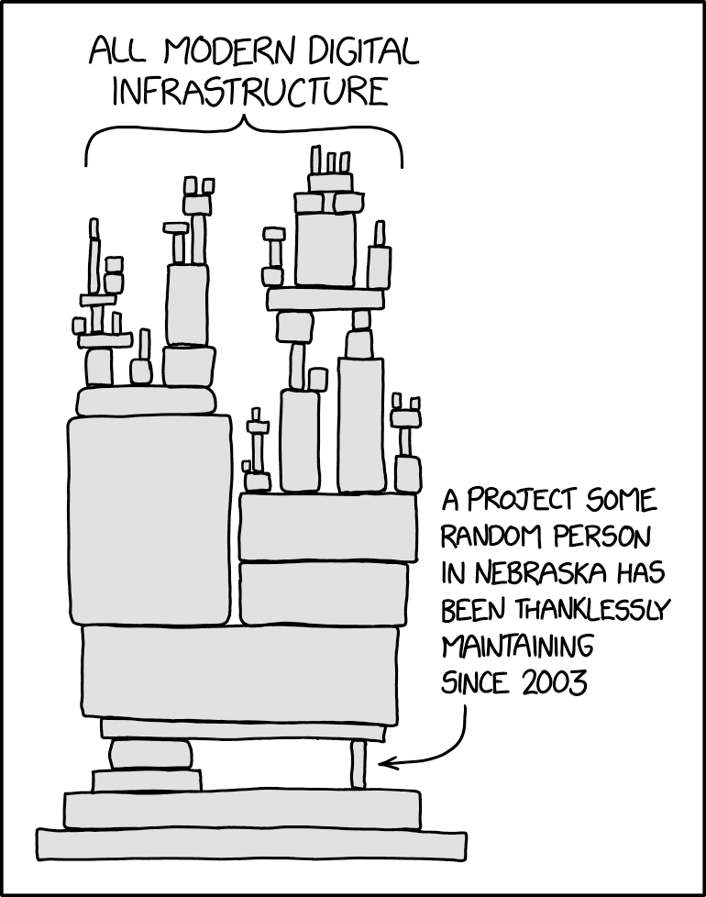
Shift Left Security: SCA + SBOM
01 SCA Software Component Analysis
SBOM
Software
Bill of Materials
https://xkcd.com/2347/

Slide 36
Shift Left Security: SCA
Software Composition Analysis
Modern software is built on Libraries. Libraries are built on top of one-another.
Libraries have flaws:
- some by mistake
- some by design
- some maliciously

Slide 37
Shift Left Security: SCA
Software Composition Analysis
How do you choose what is a safe dependency / version ?

Slide 38
Shift Left Security: SCA
Software Composition Analysis
How do you choose what is a safe dependency / version ? Manual: Synk Advisor: double check dependencies before adding to projects
https://snyk.io/advisor/search?source=python&q=pydash

Slide 39
Shift Left Security: SCA
Software Composition Analysis
How do you choose what is a safe dependency / version ? Automated way is SCA tooling

Slide 40
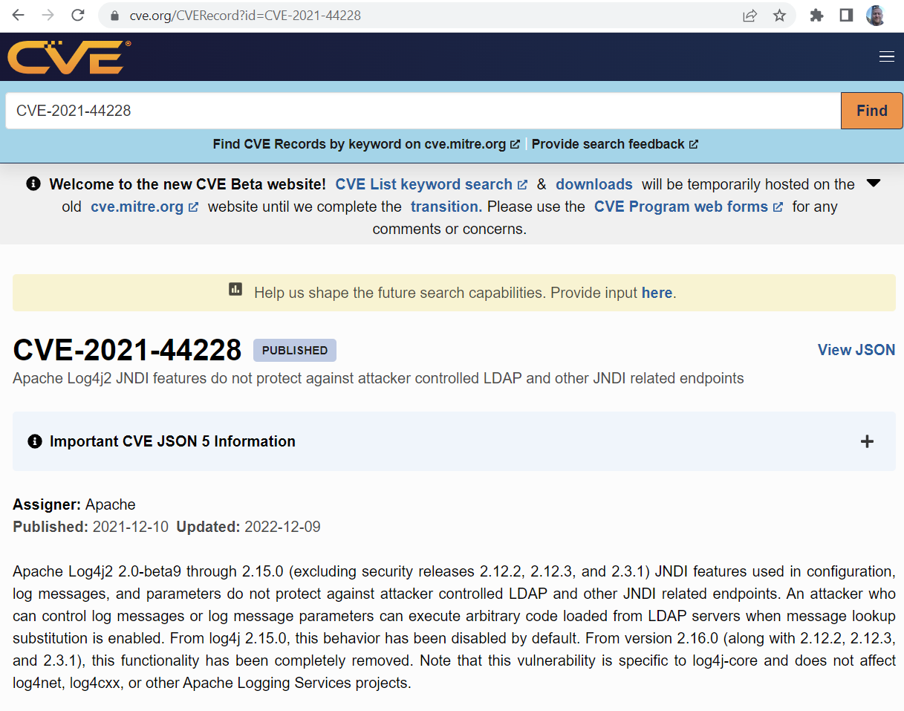
Shift Left Security: SCA
Software Composition Analysis
Modern applications and libraries are registered with CVE
Vulnerabilities are assigned a CVE number when flaws are found
These vulnerabilities can be searched by name and version of the software
https://cve.mitre.org/
https://www.cve.org/CVERecord?id=CVE-2021-44228

Slide 41
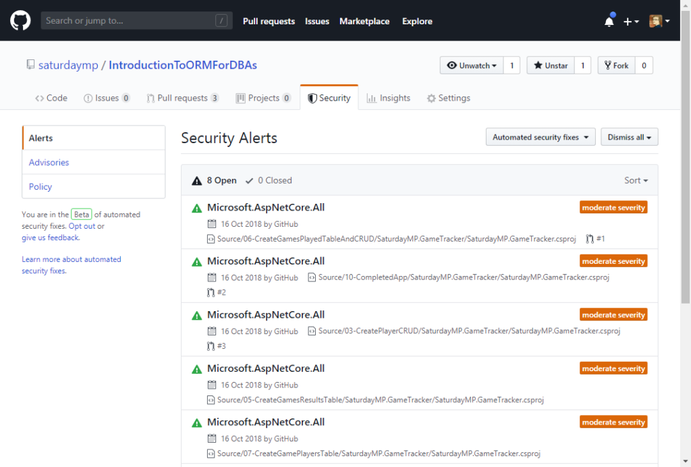
Shift Left Security: SCA
Software Composition Analysis
SCA tooling looks at all the libraries in a program’s manifest file* for known CVE registered vulnerabilities
The most common SCA software you will use is github’s dependabot
* aka pom.xml, package.json etc
https://nftb.saturdaymp.com/today-i-learned-about-githubs-dependabot/

Slide 42
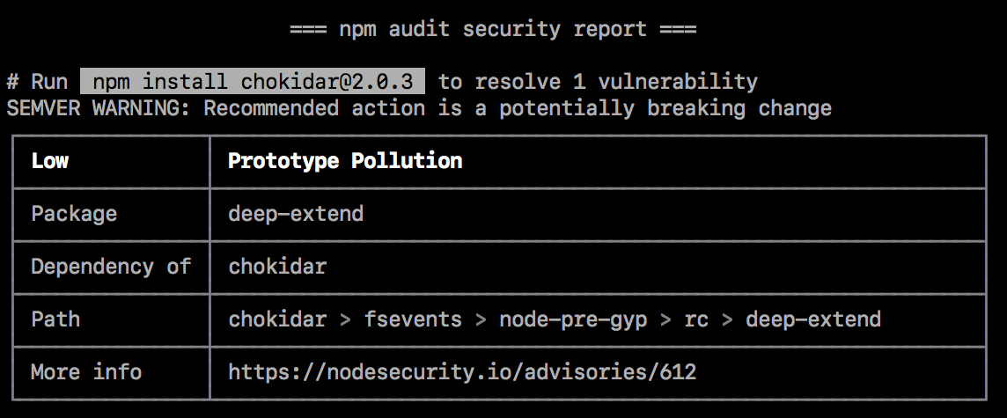
Shift Left Security: SCA
Software Composition Analysis
Other SCA software exists NODE https://docs.npmjs.com/cli/v9/commands/npm-audit npm audit
https://docs.npmjs.com/auditing-package-dependencies-for-security-vulnerabilities

Slide 43
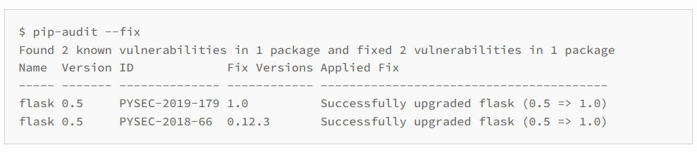
Shift Left Security: SCA
Software Composition Analysis
Other SCA software exists PYTHON
https://pypi.org/project/pip-audit/
pip install pip-audit pip-audit xxx

Slide 44
Shift Left Security: SCA
Software Composition Analysis
SCA QUESTIONS ?

Slide 45
Shift Left Security: SCA + SBOM
02 SBOM
Software
Bill of Materials
https://xkcd.com/2347/

Slide 46
Shift Left Security: SBOM
Software Bill of Materials
Modern software is built on Libraries. Libraries are built on top of one-another.
Developers often have no idea, was the nested list is…
Tooling to create SBOMs can help

Slide 47
Shift Left Security: SBOM
Software Bill of Materials
SBOM tools statically scan manifest files
They download the information of any nested libraries as well, created a Software Bill of Materials (SBOM)
* SBOM tool often carry out SCA checks against the CVE database

Slide 48
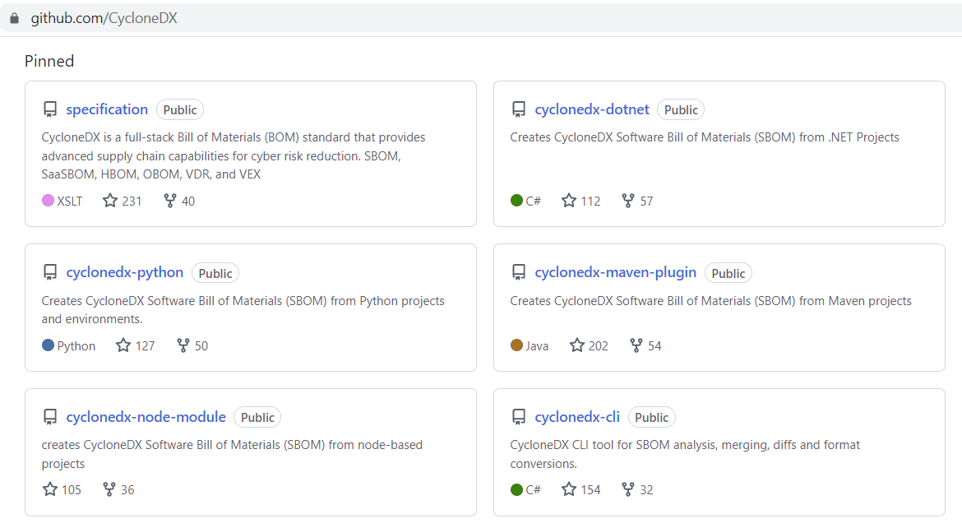
Shift Left Security: SBOM
Software Bill of Materials
SBOM industry formats are: CycloneDX – defacto standard
SPDX – older standard
Recommended SBOM Tooling https://github.com/CycloneDX

Slide 49
Shift Left Security: SBOM
Software Bill of Materials
SBOM QUESTIONS ?

Slide 50
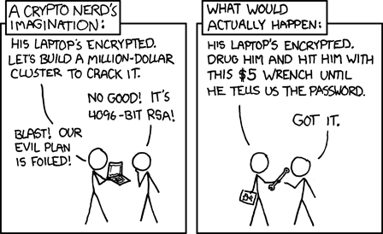
Shift Left Security: SAST
01
SAST (Secrets)
https://xkcd.com/538/

Slide 51
Shift Left Security: SAST (Secrets)
Common Security Issues:
Hardcoded Secrets
Hardcoded Passwords
Security flaws
Common programming mistakes
Library misconfiguration
Static Analysis Security Testing
Static Analysis tools run over your source code (normally via an IDE or pipeline)
They find common programming mistakes and anti-patterns

Slide 52
Shift Left Security: SAST (Secrets)
House Security 101: don’t left your keys in the lock
Software Security 101: don’t put passwords in source code* * All sensitive information including prod/dev credentials and passwords should be securely stored at REST
Static Analysis Security Testing
Hardcoded Secrets
Even if it’s one commit and the commit is overwritten it’s there forever
Unfortunately, it’s a common anti-security pattern to do so

Slide 53
Shift Left Security: SAST (Secrets)
House Security 101: don’t left your keys in the lock
Software Security 101: don’t put passwords in source code* * All sensitive information including prod/dev credentials and passwords should be securely stored at REST
Static Analysis Security Testing
SAST Secret Tools search your git history for credential and password patterns in code Two excellent SAST Secret Tools: - trufflehog - gitleaks

Slide 54
Shift Left Security: SAST (Secrets)
Run via Docker docker run \ --rm --tty --env "TERM=xterm-256color" \ -v C:\xxx:/pwd \ trufflesecurity/trufflehog:latest \ filesystem --directory /pwd \ --no-update --debug
Static Analysis Security Testing
Trufflehog https://github.com/trufflesecurity/trufflehog

Slide 55
Shift Left Security: SAST (Secrets)
docker run --rm --tty --env TERM=xterm-256color -v 'C:\xxx://data' zricethezav/gitleaks:latest detect --no-git --source=//data/ -v
Run via Docker docker run \
--rm --tty --env TERM=xterm-256color \
-v 'C:\xxx://data’ \
zricethezav/gitleaks:latest \
detect --no-git \
--source=//data/ -v
Static Analysis Security Testing
Gitleaks https://github.com/zricethezav/gitleaks

Slide 56
Shift Left Security: SAST (Secrets)
Static Analysis Security Testing
SAST Secrets QUESTIONS ?

Slide 57

Shift Left Security: SAST
https://xkcd.com/327/
01 SAST
Security Code Smells

Slide 58
Shift Left Security: SAST (Code Smells)
Common Security Code Smells:
Turning off SSL security
Misconfiguring Servers
Concatenation of SQL
Lack of Authn/z
Static Analysis Security Testing
Other SAST Tooling looks for insecure code smells
Security flaws
Common programming mistakes
Library misconfiguration

Slide 59
Shift Left Security: SAST (Code Smells)
Common Security Code Smells:
Turning off SSL security
Misconfiguring Servers
Concatenation of SQL
Lack of Authn/z
Static Analysis Security Testing
SAST Secret Tools search your code for poor security practices Three excellent SAST Secret Tools: - semgrep - kics
- codeql (inside github)

Slide 60
Shift Left Security: SAST (Code Smells)
Run via docker docker run --rm \
-v "${PWD}:/src" \
returntocorp/semgrep semgrep \
--config=auto
Static Analysis Security Testing
semgrep https://semgrep.dev/
security flaws (SAST) tool semgrep is a leading multi-language opensource solution Finds library misconfiguration, poor programming practices, etc

Slide 61
Shift Left Security: SAST (Code Smells)
Run via docker docker run --tty \
--env "TERM=xterm-256color" \
-v C:\xxx:/path \
checkmarx/kics:latest scan \
-p /path -o "/path/"
Static Analysis Security Testing
kics https://kics.io/#supportedplatforms
excellent SAST for IAC projects: aka Kubernetes, docker, and terraform Finds library misconfiguration, poor programming practices, etc

Slide 62
Shift Left Security: SAST (Code Smells)
Static Analysis Security Testing
SAST Code Smells QUESTIONS ?

Slide 63
Shift Left Security 101
…
QUESTIONS ?

Slide 64


Contact
Anthony McKale
Head of DevOps
E: anthony.mckale@6point6.co.uk
LinkedIn: https://www.linkedin.com/in/anthonymckale
I've been Anthony "Zapper" McKale
Hopefully: I've Educated, Informed, and even Entertained Thank you, for your audience 6point6.co.uk
Notes:
Add logos if you sit on any boards next to your name.

